Slide 1


Customer Data Management and Analysis
From Database Design to Data Warehousing and Visualizations
Notes:
1.7.2013
‹#›

Slide 2

Table of contents:
Project Overview
DatabaseDesign
Data Warehouse Schema
ETLProcess
Pghon Visualizations
Power Bl Visualizations
Team Members
Notes:
1.7.2013
‹#›

Slide 3




Project Overview
Objective: Develop a customer data management system integrating a transactional database, data warehouse, and data visualization.
Key Phases: Database schema design, data warehouse setup, ETL process, Python and Power BI visualizations.
Technologies: SQL Server, Python, Power BI, SSIS.
Notes:
1.7.2013
‹#›

Slide 4


1
Database Design
Notes:
1.7.2013
‹#›

Slide 5
Key Database Phases
ERD
Mapping
Database Schema
Stored Procedures
Views
Indexes
Notes:
1.7.2013
‹#›

Slide 6
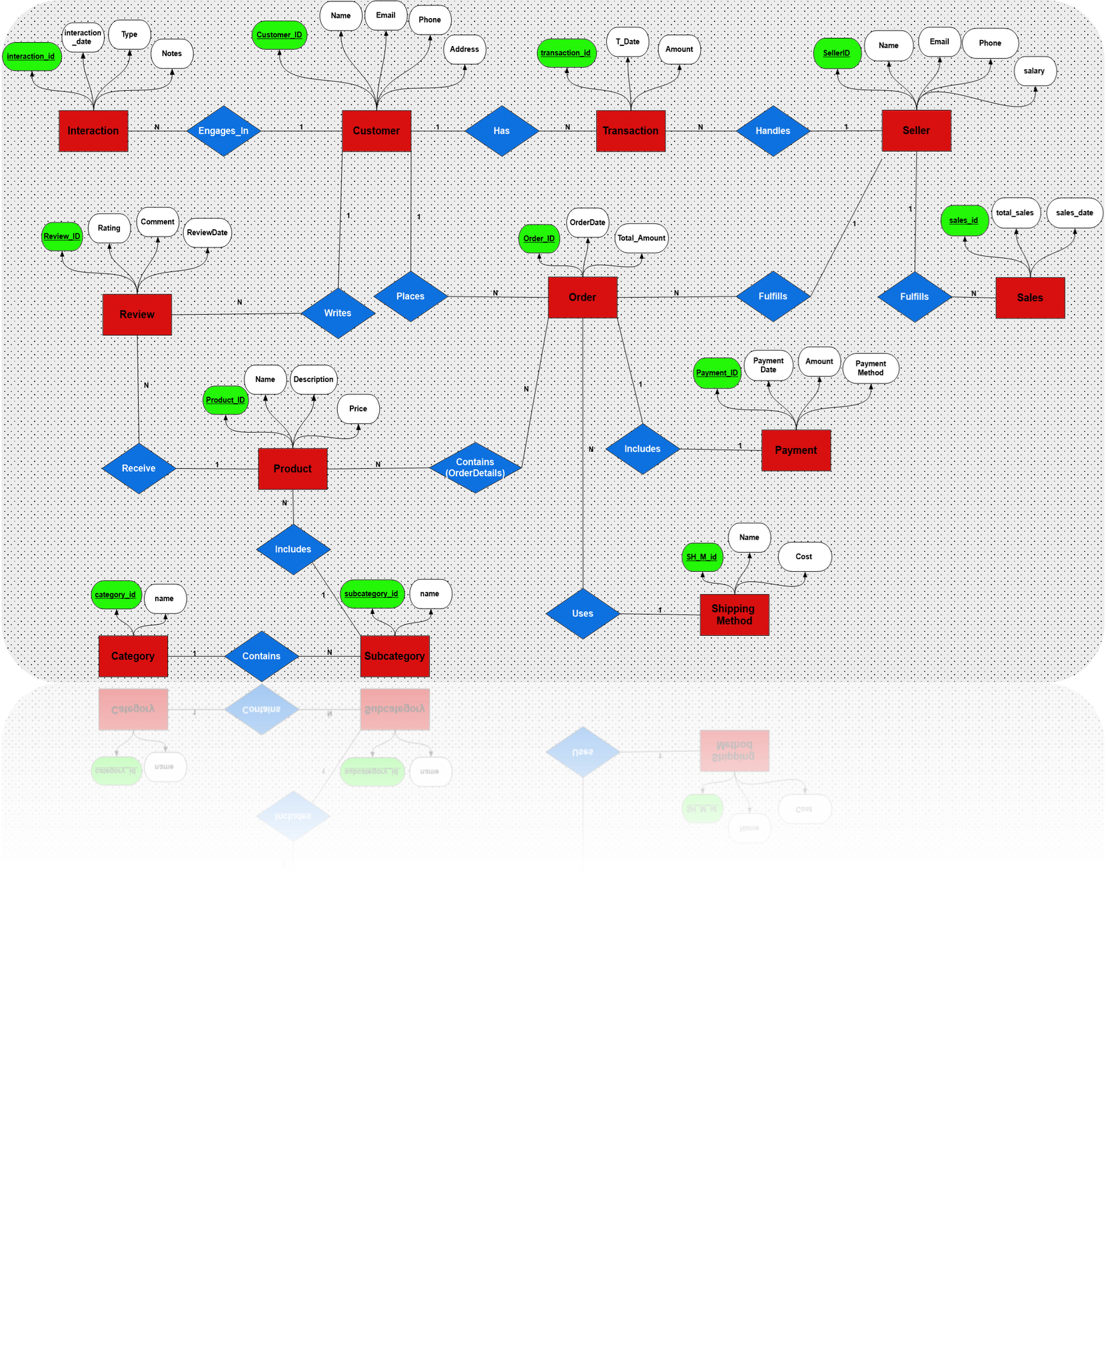
Original Database Design
Overview
Entity Relationship Diagram (ERD)
We created a relational database with key entities such as Customers, Orders, Products, Payments, and Sellers.
Key Tables
Customer, Product, Seller, Payment, Order.
Notes:
1.7.2013
‹#›

Slide 7
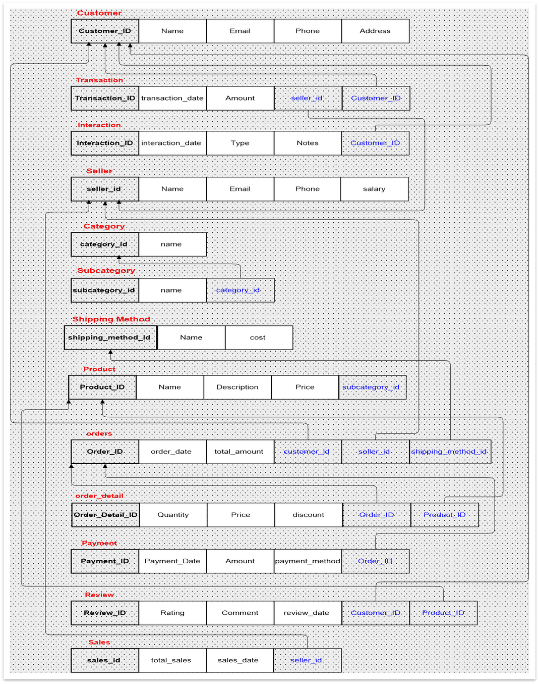
Data Mapping Overview
Notes:
1.7.2013
‹#›

Slide 8
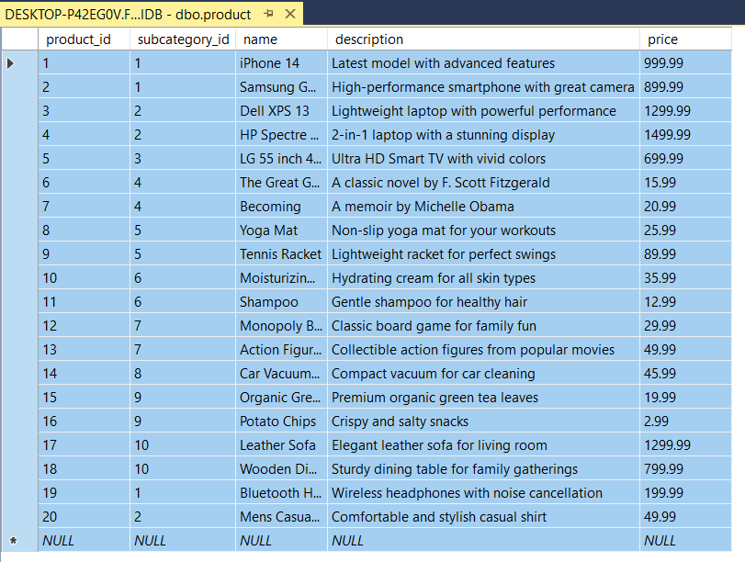
Sample data of our products
Notes:
1.7.2013
‹#›

Slide 9
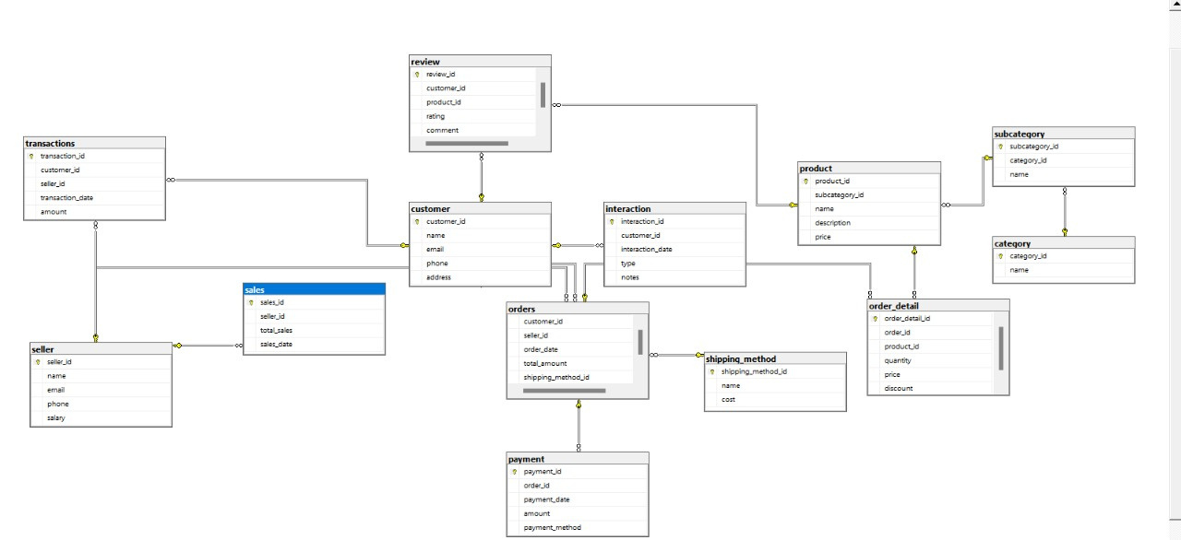
Database Schema
Notes:
1.7.2013
‹#›

Slide 10
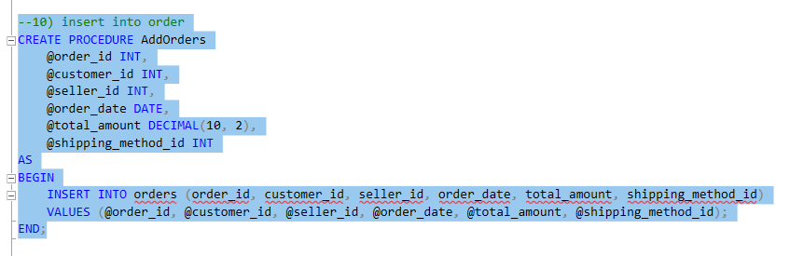
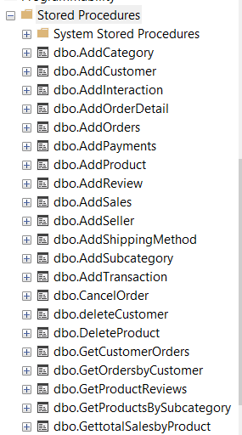
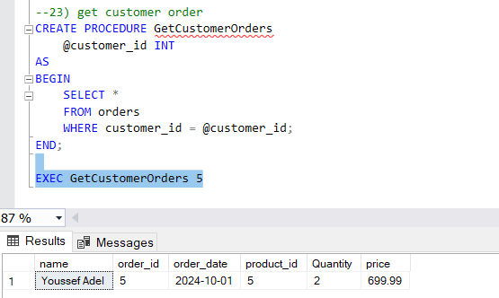
Stored Procedure to add/place new order
Stored Procedures
Some other procedures
Procedure to get the number of orders placed by a specific customer
Notes:
1.7.2013
‹#›

Slide 11
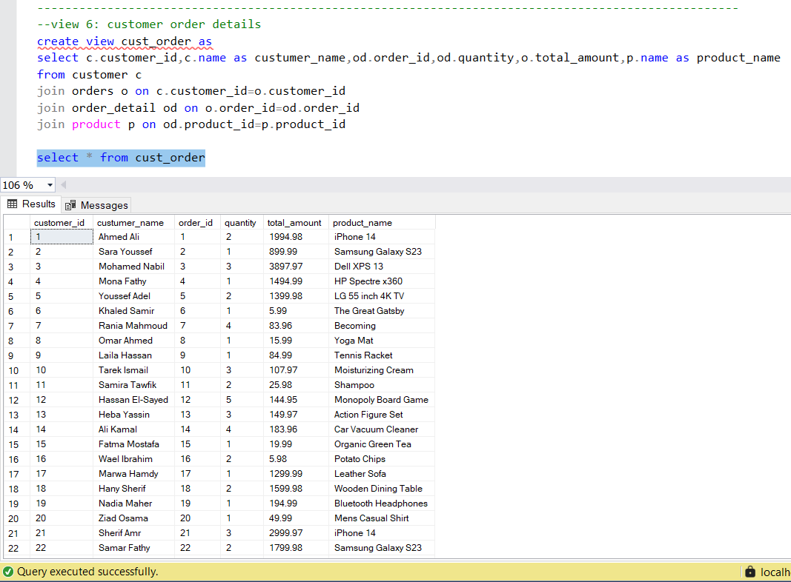
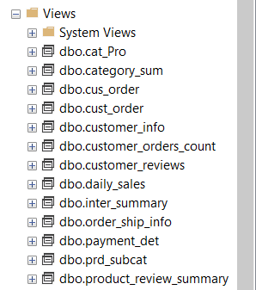
Views

Slide 12
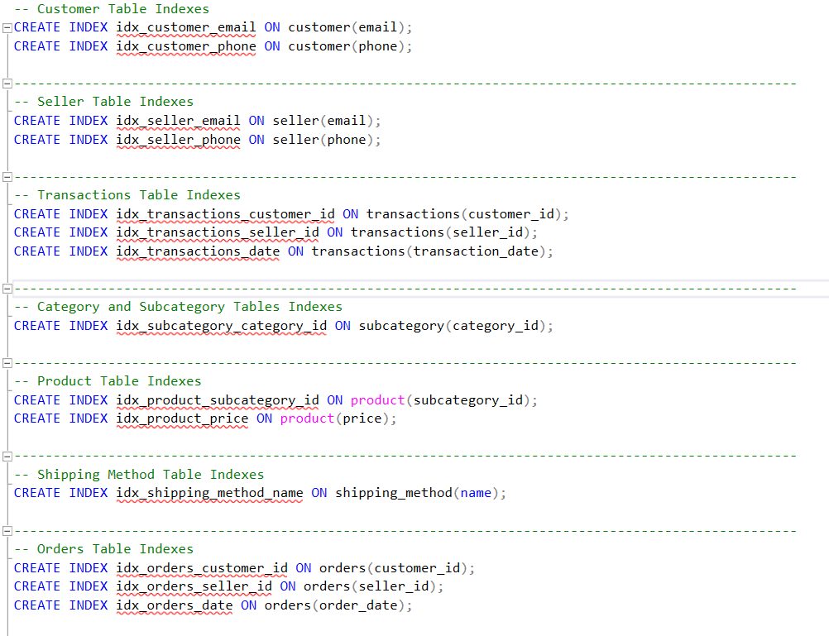
Indexes
Created for better performance and querying on the most queried columns withing each table.
Notes:
1.7.2013
‹#›

Slide 13
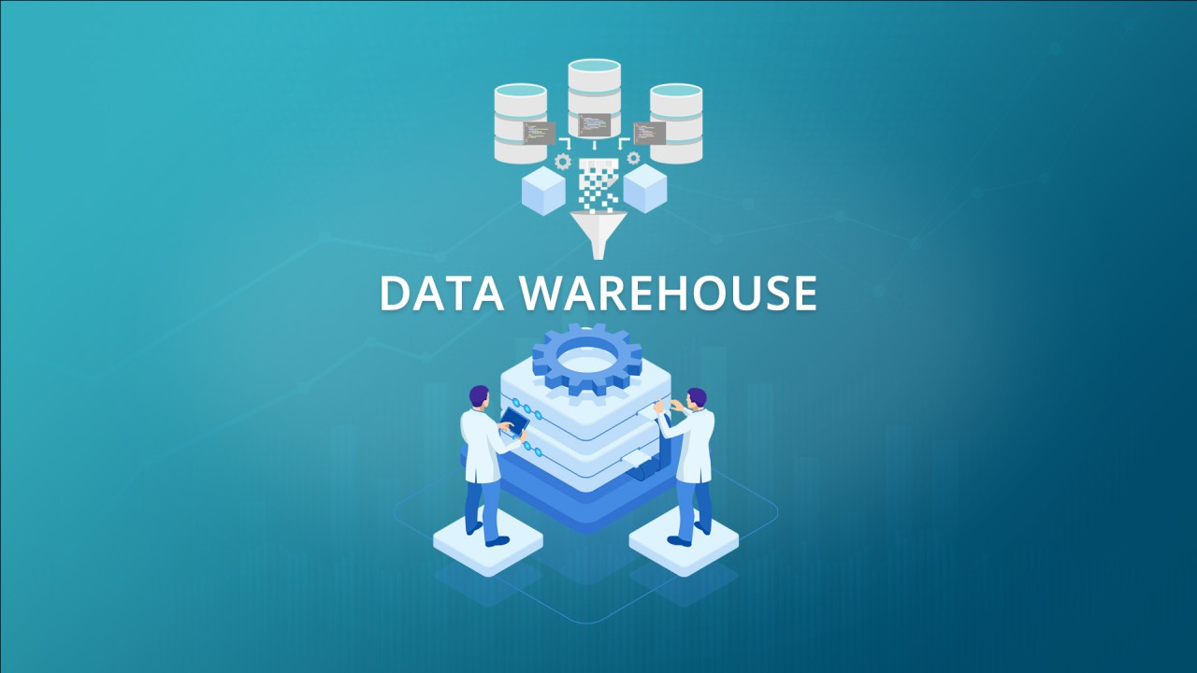
2
Data Warehouse Schema
Notes:
1.7.2013
‹#›

Slide 14
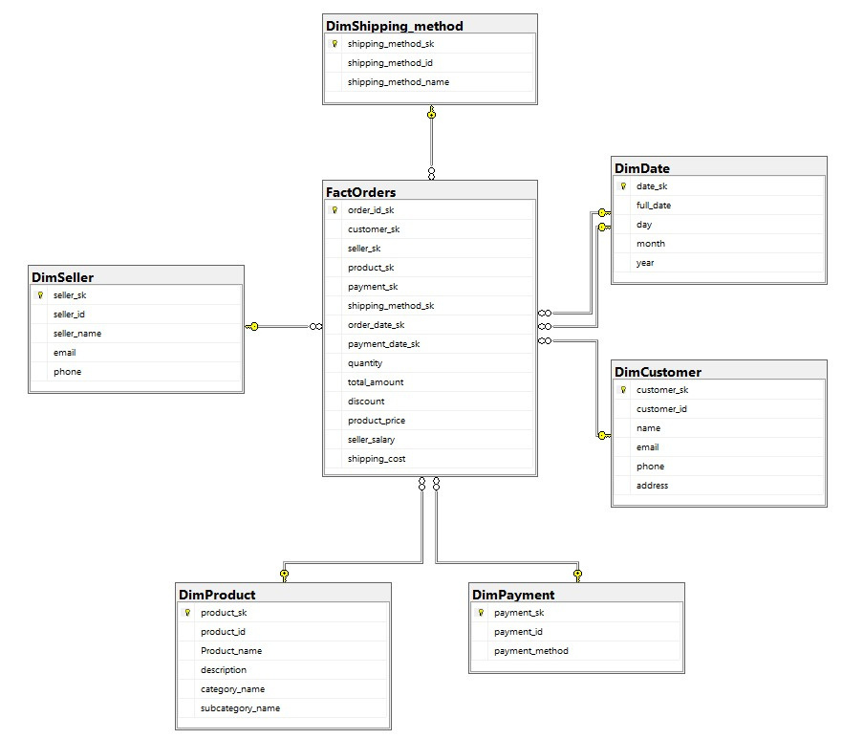
Data Warehouse Schema: (Star Schema)
Explanation: Implemented a star schema for easier querying and reporting.
Fact Table: FactOrders (storing metrics like quantity, price, total amount, etc.)
Dimensions: DimCustomer, DimProduct, DimSeller, DimShippingMethod, DimPayment, DimDate
Notes:
1.7.2013
‹#›

Slide 15
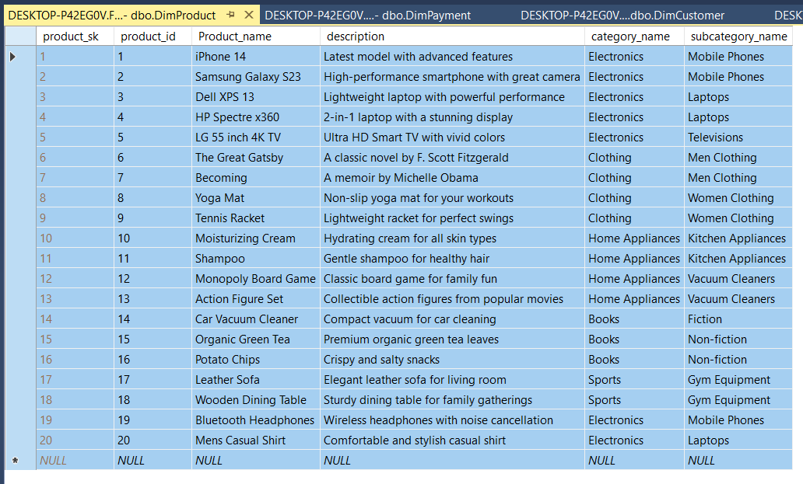
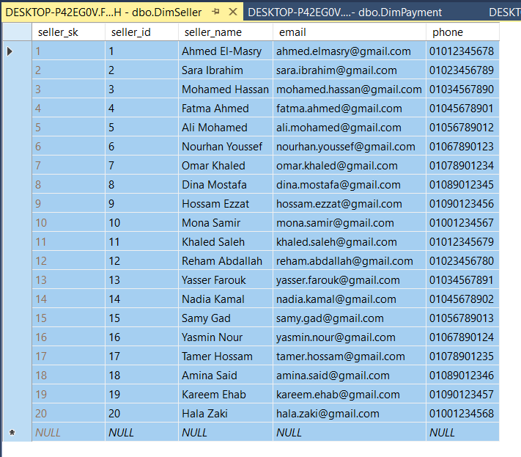
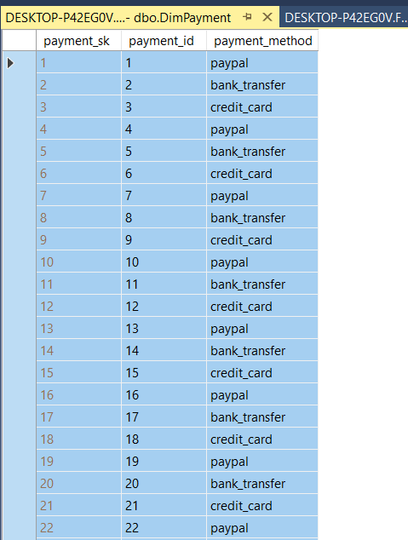
Dimension tables
Notes:
1.7.2013
‹#›

Slide 16
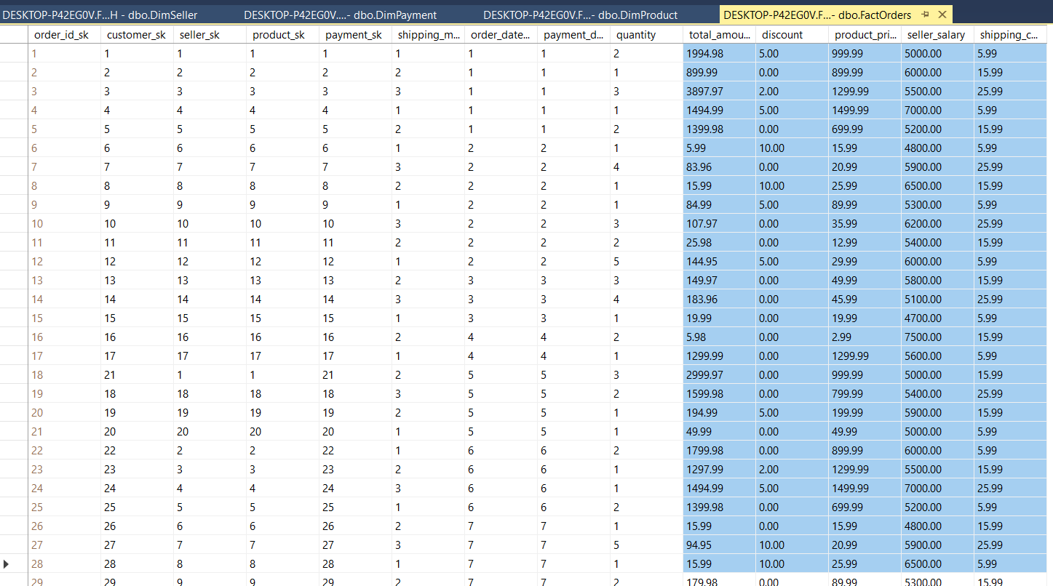
Fact table (orders)
Notes:
1.7.2013
‹#›

Slide 17
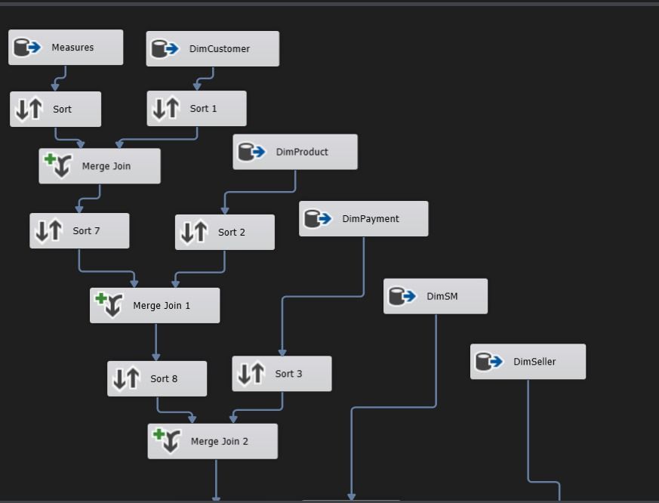
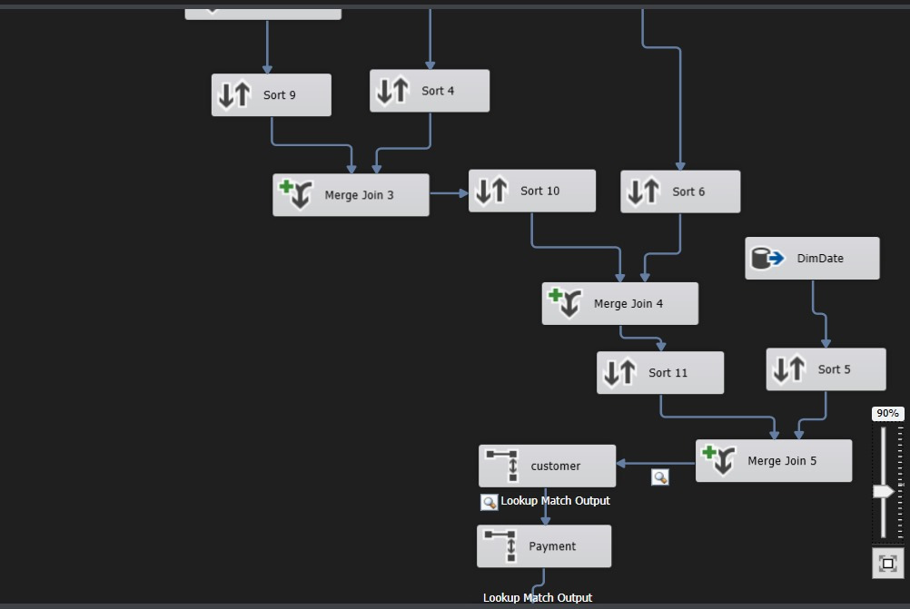
ETL Process Overview
Process: Extract data from the original database, transform it for accuracy, and load it into the data warehouse.
Tools: SQL Server Integration Services (SSIS), SQL, SSMS, VS code.
Notes:
1.7.2013
‹#›

Slide 18
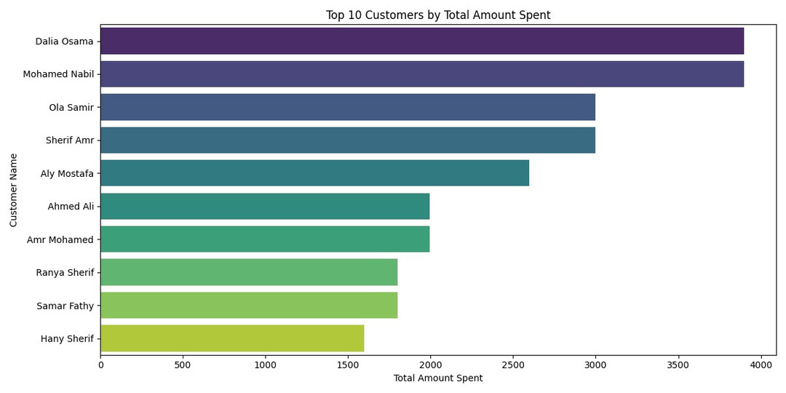
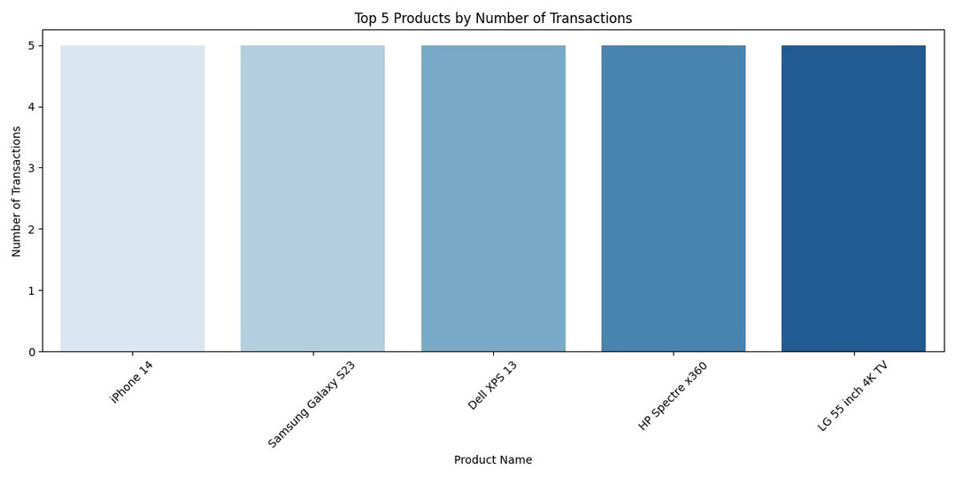
Python Data Visualizations
Overview: Visualizations were created using Python for detailed data exploration and analysis.
Visualization Examples
Top 10 Customers by Total Amount Spent
Top 5 Products by Number of Transactions
Notes:
1.7.2013
‹#›

Slide 19
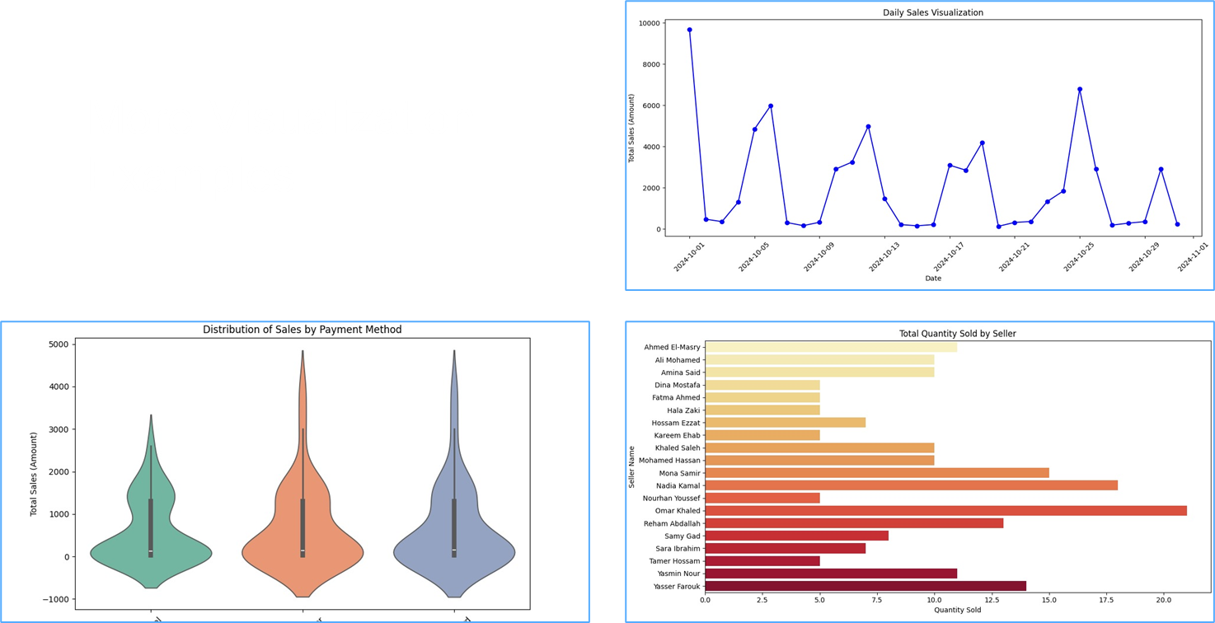
Notes:
1.7.2013
‹#›

Slide 20

Power BI Visualizations
Power BI dashboards provide real-time insights and interactivity for business intelligence.
Key Metrics: Total sales, AVG. Sellers Salary,
No. Orders and Total Sales By Category,
No. Orders By Sales Person.
Notes:
1.7.2013
‹#›

Slide 21
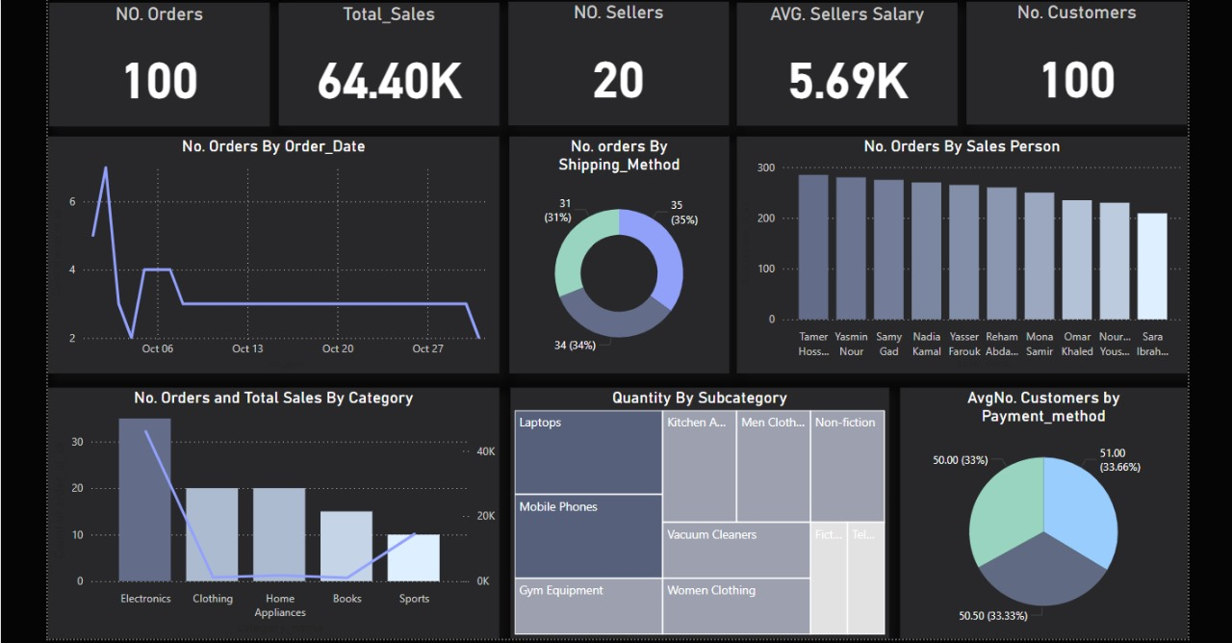
Notes:
1.7.2013
‹#›

Slide 22
Conclusion
Conclusion: Successfully integrated a customer data management system that allows for comprehensive data reporting and analysis.
Notes:
1.7.2013
‹#›

Slide 23

Presented By:
1
2
Abdelrahman Maged
Ahmed AbdElmohaimen
3
4
Mariem Ehab
Alaa Mahdy
5
6
Roqia Nabil
Ali Shaaban
Notes:
1.7.2013
‹#›

Slide 24

Thanks
Notes:
1.7.2013
‹#›

